Slide 1
PERSONALITY DEVELOPMENT

Slide 2
Objectives
The primary objective of this seminar is to develop the personality of the participants, so that they will be more confident to face other people.
To learn the importance of Personality Development.
To find out the best ways to improve the personality of a person.

Slide 3
Course Content
Meaning of Personality Development
Importance of Personality Development
Ways to improve/develop the Personality

Slide 4
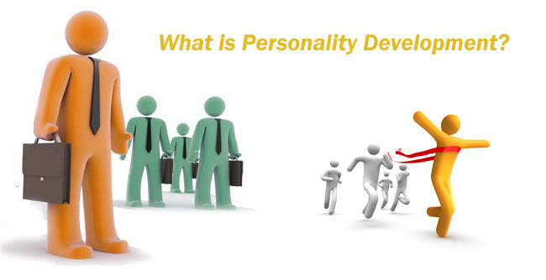
-is the development of the organized pattern of behaviors and attitudes that makes a person distinctive. Personality development occurs by the ongoing interaction of temperament, character, and environment.

Slide 5
Importance of Personality Development
helps to make a mark of his/her own
helps to reduce stress and conflicts
helps to develop a positive attitude in life
helps an individual to have positive qualities like punctuality, flexible attitude, willingness to learn, friendly nature and eagerness to help others

Slide 6
An individual with a negative attitude finds a problem in every situation
Do not blindly copy to others
IMPORTANCE
Face even the worst situations with a smile
Never hesitate to share information with others

Slide 7
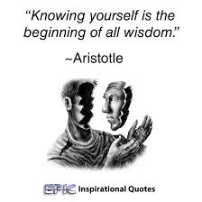

Top 12 Most Important Personality Development Tips
12. Know yourself
11. Bring positivity in your outlook

Slide 8
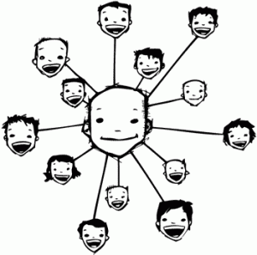

Top 12 Most Important Personality Development Tips
10. Have an opinion
9. Meet new people

Slide 9


Top 12 Most Important Personality Development Tips
8. Read more often and develop new interests
7. Be a good listener

Slide 10


Top 12 Most Important Personality Development Tips
6. Be a little fun
5. Be courteous

Slide 11
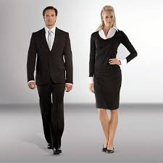

Top 12 Most Important Personality Development Tips
4. Work on your Body Language
3. Check your attire

Slide 12


Top 12 Most Important Personality Development Tips
2. Be yourself
1. Be confident

Slide 13


